Slide 1

AI Integration for ACME Learning Programs
Group 26 December 2, 2024
Notes:
Hello Everyone, We are Group 26, and today we’ll be presenting our capstone project on integrating AI into ACME’s learning programs. Let’s dive into our agenda for today.

Slide 2
Agenda
Scope
Overview
Objective
Team Information
Consluting engagement schedule objective
Budget Overview
Cost Overview
Duration Breakdowan
Resource Allocation
Project Proposed Slution Requirements
Cost Overview
Resource Allocation
Useful Insights
Project Overview
Task Cost Overview
Major Deliverables
Initial StartsTop Risks
Risk Response Startegy
Communication Techniques for Execution
Project Outcomes
Proposed Implementaion Professional
Summary
Next Steps
Notes:
Here is the agenda for today’s presentation. We will cover the project scope, an overview of the objectives, the proposed solution, risks, budget, milestones, and conclude with the expected outcomes. By the end of this presentation, you will have a comprehensive understanding of our proposed approach to integrating AI into ACME’s learning programs.

Slide 3

SCOPE
Develop and implement a scalable AI platform for 50 programs across 5 campuses by 2026, addressing stakeholder concerns, maintaining quality standards, and delivering a phased rollout plan with secure communication and testing.
Notes:
The scope of this project is to develop and implement a scalable AI platform for ACME’s 50 programs across 5 campuses by 2026. This scope defines the boundaries and deliverables that guided our planning and execution strategy.

Slide 4

Overview
The objective of the project is to deploy a scalable AI-powered learning system that improves the quality of ACME’s sales training programs. This system anticipates to improve the learning experience for participants, ensure the authenticity of content, and address concerns about program quality and job security raised by stakeholders.
Notes:
Our objective is to deploy a scalable AI-powered learning system that enhances the quality of ACME’s sales training programs. The focus is on creating a solution that balances innovation with reliability.

Slide 5


Objective of Presentation
Summarize the deliverables, key findings, and proposed recommendations.
Provide a concise and logical overview of the scope, risks, and benefits of the proposed AI integration.
Enable ACME leadership to make an informed decision on implementing the solution.
Notes:
The purpose of this presentation is to summarize our project’s deliverables, key findings, and recommendations. We will provide a clear overview of the project scope, risks, and benefits to enable ACME leadership to make an informed decision about implementing our proposed solution.

Slide 6

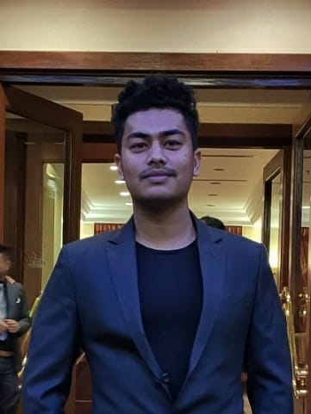
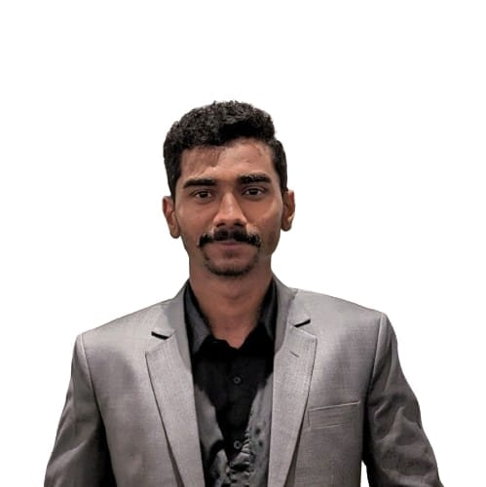
team
Yanish Shahi
Jasmeen
Shivank Giri
Notes:
Our team consists of Yanish Shahi, Jasmeen, and Shivank Giri. Together, we collaborated to develop this comprehensive solution, leveraging each member’s unique strengths and expertise.

Slide 7

Consulting Engagement Schedule
Notes:
This outlines the timeline we followed to meet the project milestones.

Slide 8





Objectives
Planning
Scheduling
Achieve Goals
Budget Management
Notes:
Our project objectives were centered around four key pillars: planning, scheduling, budget management, and achieving the defined project goals. These objectives shaped our approach and ensured that every step aligned with ACME’s strategic vision.

Slide 9



Budget Overview
Estimated Overall Cost: $2622
Resource Cost: $50/h for each resource
Notes:
The estimated overall cost for this project is $2,622, with resource costs set at $50 per hour.

Slide 10
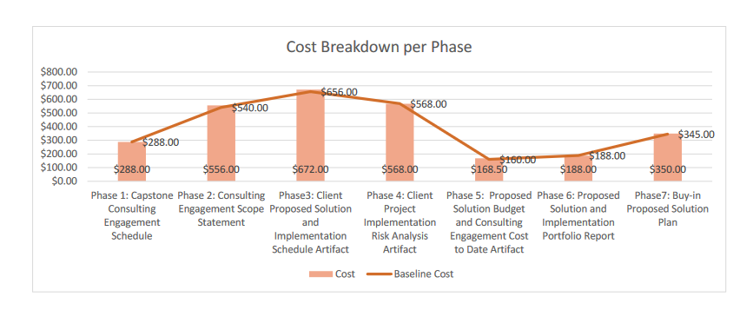
Cost Breakdown
Notes:
Here as we can see the cost breakdown in different phases of the engagement schedule.

Slide 11
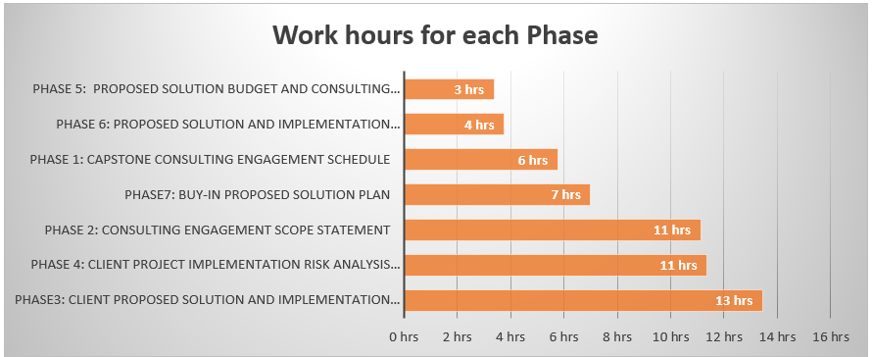
DURATION BREAKDOWAN
Notes:
So this is here duration breakdown. Summarising the working hours for each phase.

Slide 12
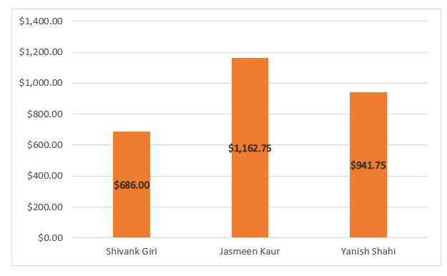
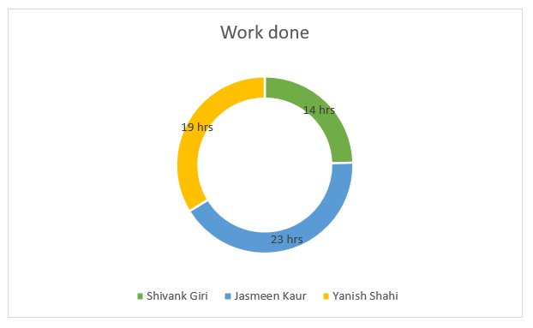
RESOURCE ALLOCATION
Notes:
Now coming onto the resource allocation and full structure on how much they worked.

Slide 13

Proposed Solution
Notes:
Our proposed solution involves developing a scalable AI system that supports 50 programs, 3,000 students, and 5 campuses. We focused on maintaining learning quality, addressing stakeholder concerns, and creating a phased rollout plan.

Slide 14

Project Requirements
Develop a scalable AI solution for 50 programs, 3,000 students, and 5 campuses.
Maintain ACME’s learning quality and content authenticity standards.
Address stakeholder concerns, ensuring investor confidence and program expert collaboration.
Deliver a comprehensive implementation plan with budget, risk analysis, and secure communication protocols.
Execute a phased rollout, achieving full implementation by September 2026.
Provide final deliverables: a detailed report and a professional presentation for leadership approval.
Notes:
To meet ACME’s requirements, we designed a scalable AI solution with specific deliverables, including stakeholder collaboration, secure communication protocols, and a phased rollout. The final implementation plan is set to be completed by September 2026.

Slide 15
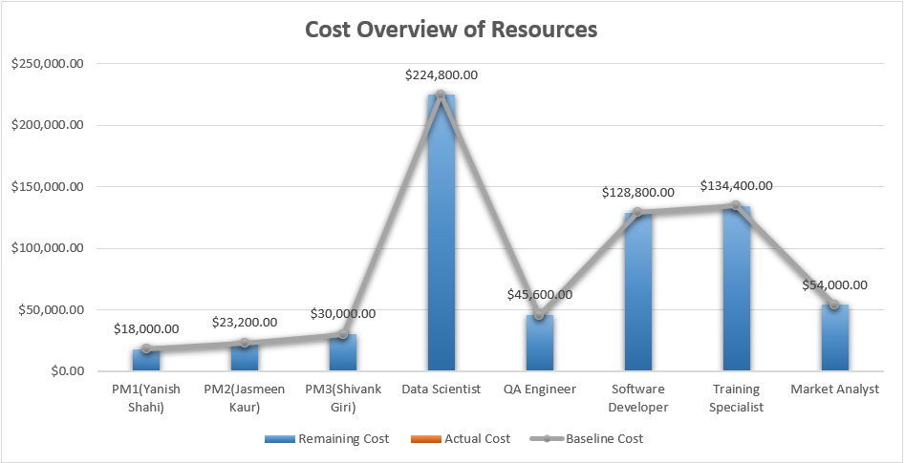
COST OVERVIEW
Notes:
This is the cost overview of resources. This is well structured with every detail possible.

Slide 16
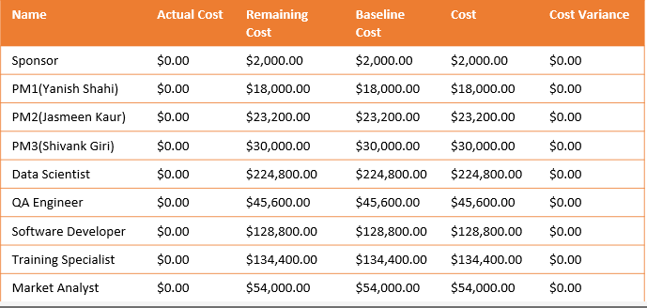
RESOURCE ALLOCATION
Notes:
This is resource allocation for the proposed solution.

Slide 17
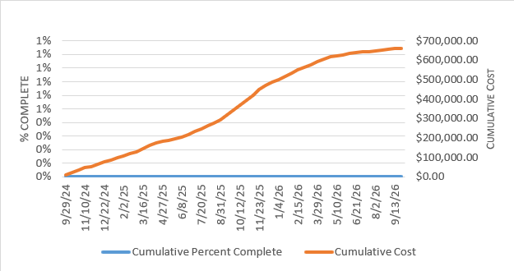
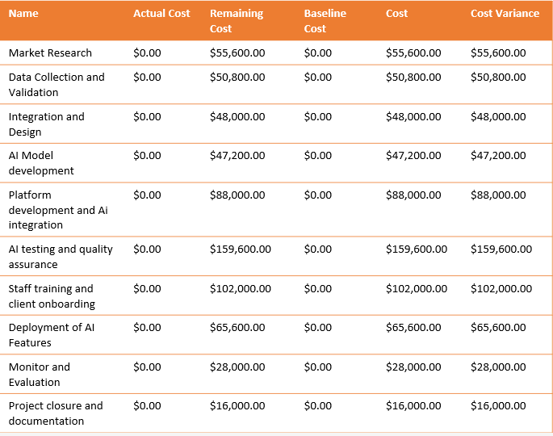
USEFUL INSIGHTS
Progress vs Cost
Cost table for each Phase
Notes:
Here are some very crucial insights.

Slide 18
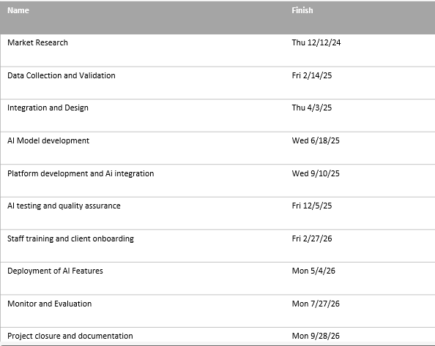
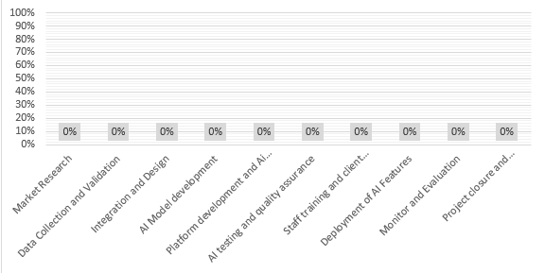
PROJECT OVERVIEW
Milestone Due
Phases Completion
Notes:
This is complete project overview with milestones and phase completions.

Slide 19
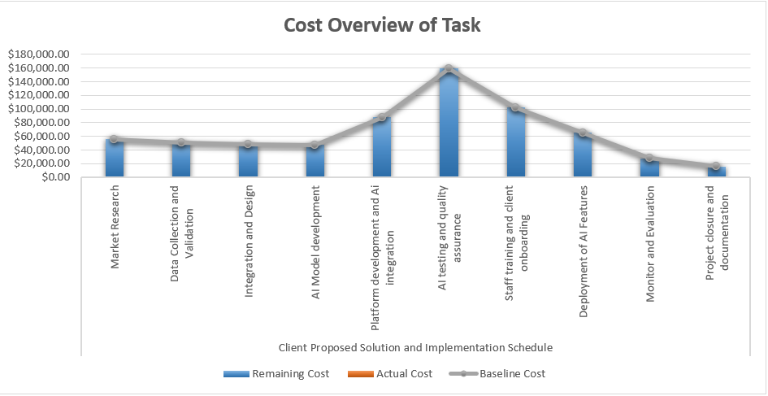
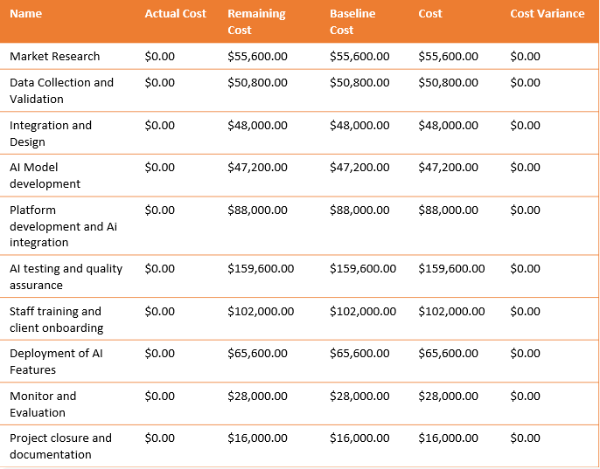
TASK COST OVERVIEW
Task Cost breakdown
Phases Completion
Notes:
And this is task cost overview with complete detaling.

Slide 20

MAJOR MILESTONES
Research AI tool for learning Platforms.
Gather ACME's program data.
Design AI integration framework.
Develop AI algorithms for personalized learning.
Develop AI features in platform.
Create AI test cases.
Develop training materials for AI use.
Deploy AI tools.
Establish Monitoring Framework.
Compile project documentation.
Notes:
Here are the major milestones of the project. These include researching AI tools, gathering data, designing integration frameworks, developing AI algorithms, conducting testing, and deploying the final solution. Each milestone represents a critical step toward project success.

Slide 21
INITIAL STARTS
Team Kick Off Meeting.
Find Out Goals And Scope.
Start Developing A Project Schedule.
Start Looking For Tools And Resources.
Notes:
These are some initial steps to get started.

Slide 22
TOP RISK'S
Integration Failure.
Skill Gap And Training Deficiencies.
Data Security Breaches.
Notes:
Here are some of the top risks of the project. We identified three major risks: integration failures, skill gaps, and data security breaches.

Slide 23
RISK RESPONSE StRATEGY
Integration Failure
Data Security Breach
Skill Gap And Training Deficiencies
Responses: 1. Conduct pre-integration testing. 2. Assign a dedicated teachnical team.
Contingency: 1. Set up a shadow system. 2. Maintain a backup plan
Responses: 1. Empolyee Training. 2. Workshops with documentation.
Contingency: 1. Partber with external experts. 2. Introduced Phased AI Rollout.
Responses: 1. Data Encryption. 2. Use secure services.
Contingency: 1. Incident response team. 2. Moniter systems.
Notes:
For each, we proposed strategies such as pre-integration testing, employee training, and robust encryption protocols. These measures mitigate risks and ensure project stability.

Slide 24
COMMUNICATION TECHNIQUES FOR EXECUTION
Make A Good Communication Plan.
Frequent Updates.
Meetings with Stakeholders.
Notes:
This is the communication plan for the implementation.

Slide 25

PROJECT OUTCOMES
Enhanced Academic Achievements.
Flexible Growth.
Boosted Enagegment.
Sustained Competitive Edge.
Eco-Friendly Progress
Notes:
Our project outcomes include improved sales performance, reduced costs, enhanced participant satisfaction, and increased engagement. The solution positions ACME as a leader in AI-driven education, fostering long-term success and stakeholder confidence.

Slide 26
Summary
Our project aims to integrate AI into ACME’s sales training, enhancing performance, reducing costs, and improving participant satisfaction. The approach focuses on system evaluation, AI tool selection, and personalized learning, addressing challenges like resistance to change, skill gaps, and data privacy.
Notes:
In summary, this project integrates AI into ACME’s learning programs to modernize training and address stakeholder concerns. By focusing on scalability, quality, and innovation, we’ve provided a solution that ensures sustainable growth and success for ACME.

Slide 27
NEXT STEPS
Take feeback from the Sponsers.
1
Wait for the approval.
2
Notes:
The next steps involve finalizing stakeholder buy-in, implementing the phased rollout, and monitoring the AI system’s performance to ensure it delivers the desired outcomes.

Slide 28

Thank you
Notes:
Thank you for your time and attention. We look forward to your feedback.

